Slide 1
DECODE the number
Game design step by step
// numeric peg system use to memorise numbers long term
// teach user to the associate and remember image to the 0-9 number
//Game 1 Cipher picture to correct number
// game 1 ask for user input "string number"
Notes:
pseudocode

Slide 2
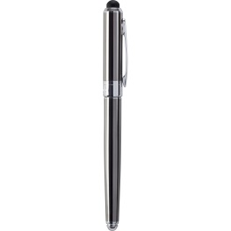
Level 1
Decode the Number from the picture?
TEXT BOXES E.g “1”
Submit
Need bootstrap to create a submit button for user to enter string “Number”
Need code for a text box for the user to enter the number.
Notes:
pseudocode
// need code to load image and generate a one random 0-9 picture
// img size width=60px height=60px
// need to store number and images into a dictionary
var imagesDict = {
"0": "football.jpg",
"1": "pen.jpg",
"2": "swan.jpg",
"3": "McDonald.jpg",
"4": "chair.jpg",
"5": "hook.jpg",
"6": "cherry.jpg",
"7": "thunder.jpg",
"8": "track.jpg",
"9": "ballon.jpg",
};
// ask for user to enter the a string number, need to code so it accept string number only
// submit button

Slide 3
If statement: ANSWER
Decode the Number from the picture?
String “1” Correct
Next
Code for Next button to change random pic
Need code to display the user string Number
Notes:
pseudocode
// need a for loop if statement if answer correct display answer
// need code to print answer string number
// need next button to change random picture
// next level if user get 10 answer correct, show 2 random picture and ask for user to guess 2 digit number etc.

Slide 4
For loop Else statement: wrong
Decode the Number from the picture?
Wrong answer, please enter a number?
Wrong answer text appear
TEXT BOXES E.g “1”
Submit
Notes:
pseudocode
// need a for loop else statement if user enter wrong answer or not a string number show same number picture with text “Wrong answer, please enter a number?”

Slide 5

Decode the Number from the picture?
TEXT BOXES E.g 1
Submit
Need code to random change picture, after user guess first answer
Notes:
Pseudocode
// need code to load image and generate a one random 0-9 picture after user guess the answer
//imageload

Slide 6

Next stage decode 2 number
Decode the Number from the picture?
TEXT BOXES E.g 31
Submit
After user get 10 answer correct, need code for random 2 digit picture
Notes:
Pseudocode
// next level after user get 10 answer correct, show 2 random picture and ask for user to guess 2 digit number etc.
// need code to load image and generate a two random 0-9 picture after user guess the answer

Slide 7
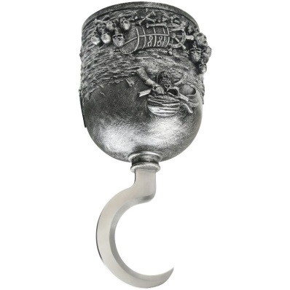
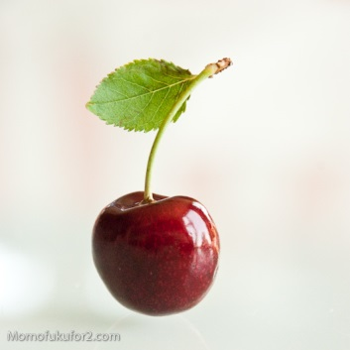
Next stage decode 3 number
Decode the Number from the picture?
TEXT BOXES E.g 563
Submit
Notes:
Pseudocode
// next level after user get x amount correct, show 3 random picture and ask for user to guess 3 digit number etc.

Slide 8
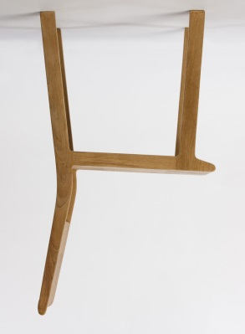
Next stage decode more number
Decode the Number from the picture?
Need code to generate random 4 digit picture etc. after getting x amount right
TEXT BOXES E.g 4141
Submit
Notes:
Pseudocode
// next level after user get x amount correct, show 4 random picture and ask for user to guess 4 digit number etc.

Slide 9


Next stage decode more number
Decode the Number from the picture?
TEXT BOXES E.g 240711
Submit
Notes:
Pseudocode
// stage get harder after user get x amount correct, show random picture and ask for user to guess digit number etc.

Slide 10
Chunking/story telling
Decode the Number from the picture?
TEXT BOXES E.g 306,526,411
Submit
Notes:
Pseudocode
// future level will use RECAP memory technique with numeric peg system
// end goal to implement/utilise chunking and storytelling technique with numeric peg system
// memorise long digit long term
// chunking where you group number together
// story telling where you make the user create a short story eg. 306, 526, 411
360== at Mcdonald there ball made of cherry
526== captain hook eating a swan and cheery for dinner
411== a chair with 2 pen on it

Slide 11


Numeric peg system
0 =
1 =
2 =
3 =
4 =
5 =
6 =
7 =
8 =
9 =

